Slide 1
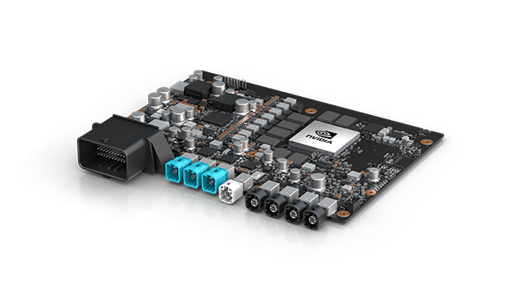



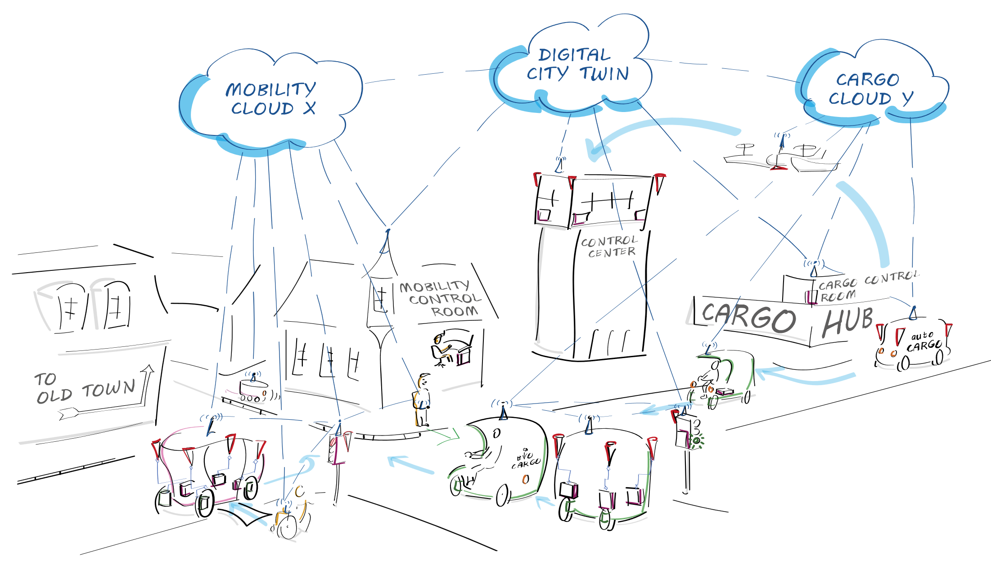

Distributed
Computing Platform
Utilizing unused computing resources of autonomous vehicles
Summary →
Autonomous vehicles use powerful hardware to carry out the necessary driving functions. However, this computing power is often unused in certain scenarios, such as when parking. To improve resource efficiency, this unused computing power could be made accessible as a general-purpose computing platform. In a similar way to server clusters in IT infrastructures, multiple autonomous vehicles could be pooled together to create a distributed computing cluster.
Representative Image →
State of the Art
Autonomous vehicles are still the subject of ongoing research. The concept of a distributed computing platform consisting solely of autonomous vehicles only becomes viable when there are a large number of them. Although there are existing concepts for such use cases, there is currently no commercially available implementation for automotive applications.
Technological Innovations
A prototype implementation of a distributed computing platform is developed for automotive application. Particular attention was paid to ensuring compatibility with common autonomous hardware architectures, as well as identifying the necessary features to minimise unnecessary complexity.
Contributing Partners
Highlight Elements →
← Contributing Partners

